Slide 1
PATHWAYS, AN OVERVIEW
District 70
Australia
Notes:
Hello and welcome to this presentation of Pathways, an Overview. Thank you for joining us on this District 70’s Second Sunday Monthly Sessions.

Slide 2
Presenter
Sebastian Sabater, DTM
District 70 Pathways Team Leader
Notes:
My name is Sebastian Sabater, I am the District 70 Pathways Team Leader and have been working on Pathways for the last four years…

Slide 3
Agenda
Pathways, Eleven Paths
Pathways Levels Explained
Challenging Projects
Questions
Notes:
Today’s Agenda includes information on… (read from the screen up to Challenging Projects)
At the end we’ll have a Q&A session where I will do my best to explain and answer any queries you may have.

Slide 4
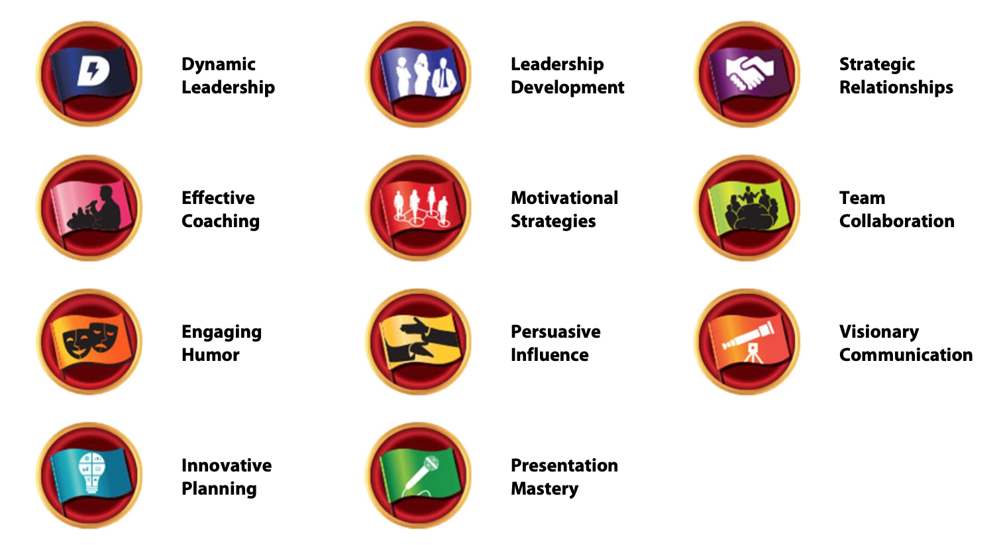
Pathways has Eleven Paths…
Notes:
The Pathways Educational Program currently has eleven distinctive Paths, each of them designed for you to build different types of skills, which include Leadership, People's Relationships, Coaching, Strategies, Team Work, Humour, Influencing People, Communication, Planning and Presentation.

Slide 5
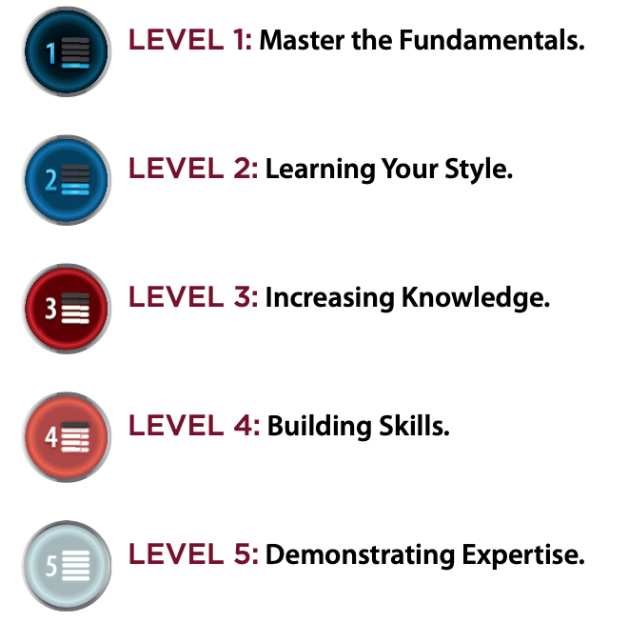
Five Levels in each Path…
Learn the fundamentals to become a successful Public Speaker and Evaluator.
Develop an understanding of your personal styles and preferences.
Begin increasing your knowledge of skills specific to your Path.
Build the skills you need to succeed on your Path.
Demonstrate your expertise in the skills you have learned.
Notes:
Each Path has five levels, which, as you progress through them, increase in difficulty.
In Level ... (read from screen as each level appears)

Slide 6
Ice Breaker
Evaluation and Feedback
Researching and Presenting
Notes:
Level 1 is common to all eleven Paths and it includes (read from screen as the items appear)

Slide 7
Two required projects, choosing from…
Body Language, Cross-Cultural Understanding,
Managing Time, Listening Skills,
Sense of Humour, Leadership and Management Styles
Introduction to Toastmasters Mentoring
Notes:
Level 2 requires you to prepare two Projects from a list that includes... (read as they appear)
And then you work on a Project that will introduce you to Mentoring.

Slide 8
One required project
A minimum of two elective projects
From14 possible choices, including…
Active Listening, Networking, Humorous and Inspirational Talks,
Preparing for an Interview, Using Presentation Software
Notes:
Level 3 requires you to work on a Project that is directly related to the Path you chose.
Then you need to work on two more Projects which you can choose from a list of 14 choices, including (read from screen).

Slide 9
One required Project
A minimum of one elective Project
From 8 possible choices, including…
Creating a Podcast, Managing Online Meetings,
Writing a Blog, Managing Difficult Audiences
Notes:
Level 4 requires you to work on a Project that is directly related to the Path you chose.
Then you need to work on more Project which you can choose from a list of 8 choices, including (read from screen).

Slide 10
One required Project
A minimum of one elective Project
From 6 possible choices, including…
Ethical Leadership, Leading a Volunteer Organisation,
Speaking Professionally, Panel Discussion Moderator
Reflect on Your Path
Notes:
Level 5 requires you to work on a Project that is directly related to the Path you chose.
Then you need to work on one more Project which you can choose from a list of 6 choices, including (read from screen).
These complete Level 5, but to fully complete the Path, you must present another Project, "Reflect on Your Path" which requires you present a 10 to 12 minutes speech to tell your audience what you learnt the experiences you had while working through your Path.

Slide 11
Challenging Projects
Building a Social Media Presence:
This Project addresses how to best use different types of online communication. It shows you how to create and maintain an online profile to promote yourself or an organization.
Create a Podcast:
This Project addresses the skills you need to develop a podcast, create interesting content and organise a cohesive program. You will learn how to record and upload it to the internet.
Notes:
Now that we’ve seen the way Pathways is structured, I would like to show you a sample of the more challenging Projects you can attempt.
Most of these Projects are available as “electives” in Levels 3, 4 and 5.
Building a Social Media Presence (read from the screen)
Create a Podcast (read from the screen)

Slide 12
Challenging Projects
Cross-Cultural Understanding:
This project focuses on understanding the cultures with which you most closely identify and the impact of stereotypes associated with your cultures and others.
Focus on the Positive:
This project addresses strategies for improving your personal interactions by understanding the impact of your attitudes and thoughts on daily interactions.
Notes:
Cross Cultural Understanding (read from screen)
Focus on the Positive (read from screen)

Slide 13
Challenging Projects
Manage Online Meetings:
This project addresses how to effectively conduct online meetings and webinars, prepare and organize necessary visual aids, and lead with confidence.
Managing a Difficult Audience:
This project covers common behaviours of difficult audience members and how to address each behaviour in a calm, effective and professional way.
Notes:
Manage Online Meetings (read from the screen)
Managing a Difficult Audience (read from the screen)

Slide 14
Challenging Projects
Prepare for an Interview:
This project addresses the skills you need to identify and speak about personal strengths and present yourself well in an interview of any type.
Write a Compelling Blog:
This project addresses the basics of developing a compelling blog and successfully engaging a readership. It challenges you to post a minimum of eight blog posts in one month.
Notes:
Prepare for an Interview (read from the screen)
Write a Compelling Blog (read from the screen)

Slide 15
In Summary, we have learnt…
The Paths currently available on Pathways
The number of levels on each Path and their purpose
The contents of some of the more Challenging Projects
Notes:
In Summary, what have we learnt?
Read each line as it appears.

Slide 16
Questions?
Notes:
Are there any questions?

Slide 17
Notes:
Many thanks for your interest and attention.

