Slide 1
PATHWAYS, LEVEL APPROVAL PROCESS
District 70
Australia
Notes:
Welcome to this session on How to Approve Completed Projects in Pathways

Slide 2
Agenda
Notifications from Base Camp and Club Central.
The Two Step Process.
How to Log in as a Base Camp Manager.
How to Approve or Reject a Level Completion.
How to Access Club Central
How to Lodge an Achievement in Club Central.
Notes:
This session will show you…

Slide 3
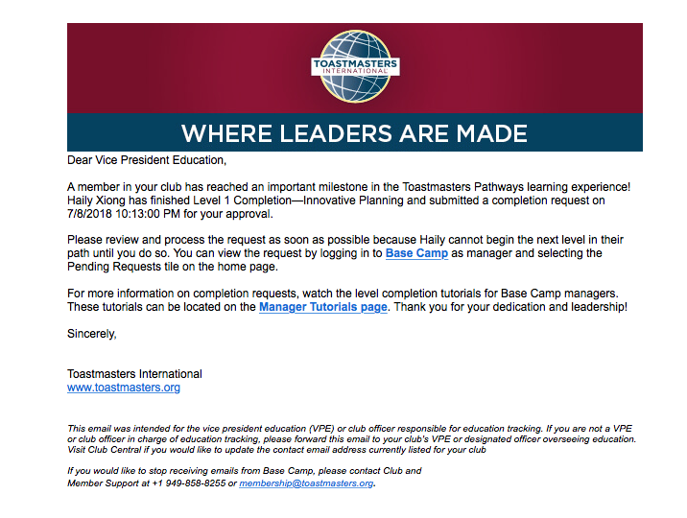
Notes:
Notification to Base Camp Managers of Member’s Level Completion

Slide 4
In Pathways, Level Approval is a two step process.
The Base Camp Manager MUST:
Approve the Level completion in Base Camp
  (this will give the Member credit for the having completed the Level)
Enter the Level completion in Club Central
(this will lodge the achievement in the Distinguished
Club Program)
Notes:
Approval is a two Step Process, Levels must be approved on Base Camp to credit the member for having completed the Level and then in Club Central, to lodge the achievement in the Club’s DCP. Note that if a Member is in more that one Club, he/she will decide which Club takes the DCP Credit.

Slide 5
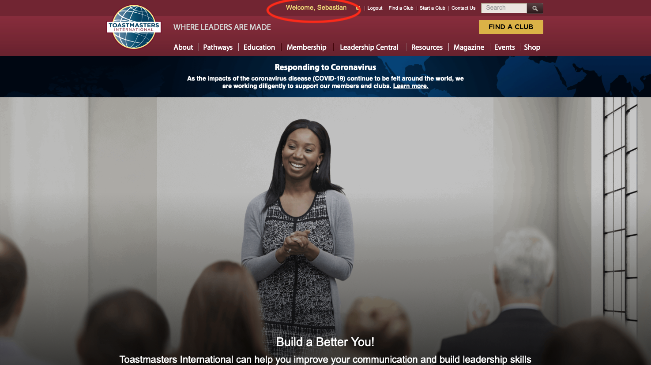
Notes:
Login to T.I. and then click on your name (in yellow, at centre top of the page)

Slide 6
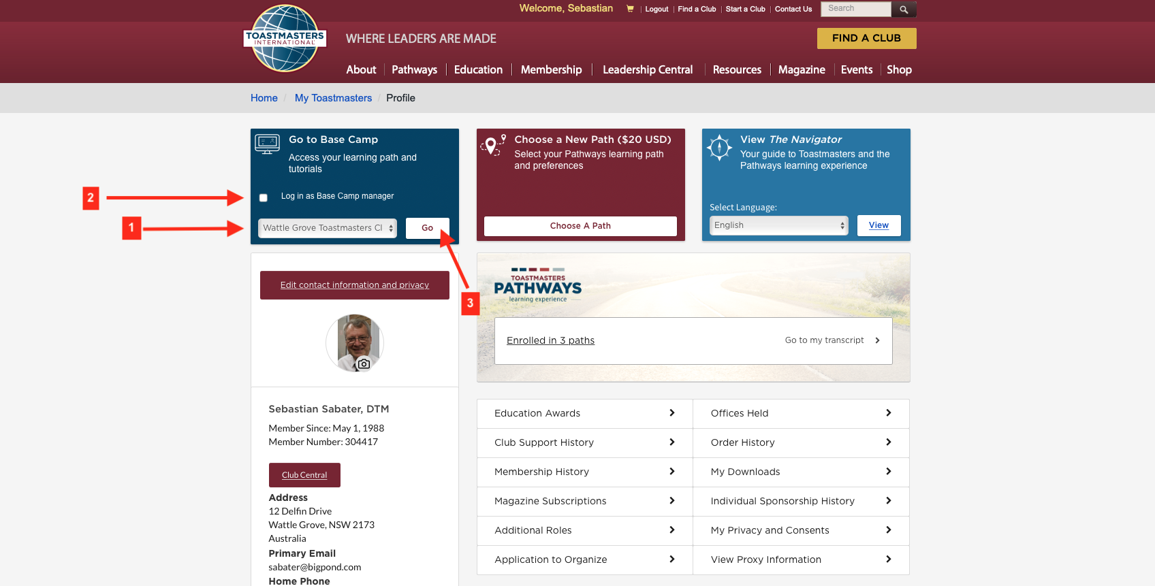
Notes:
Choose the relevant Club, click on the white square to log In as a Base Camp Manager and then click on “Go”

Slide 7
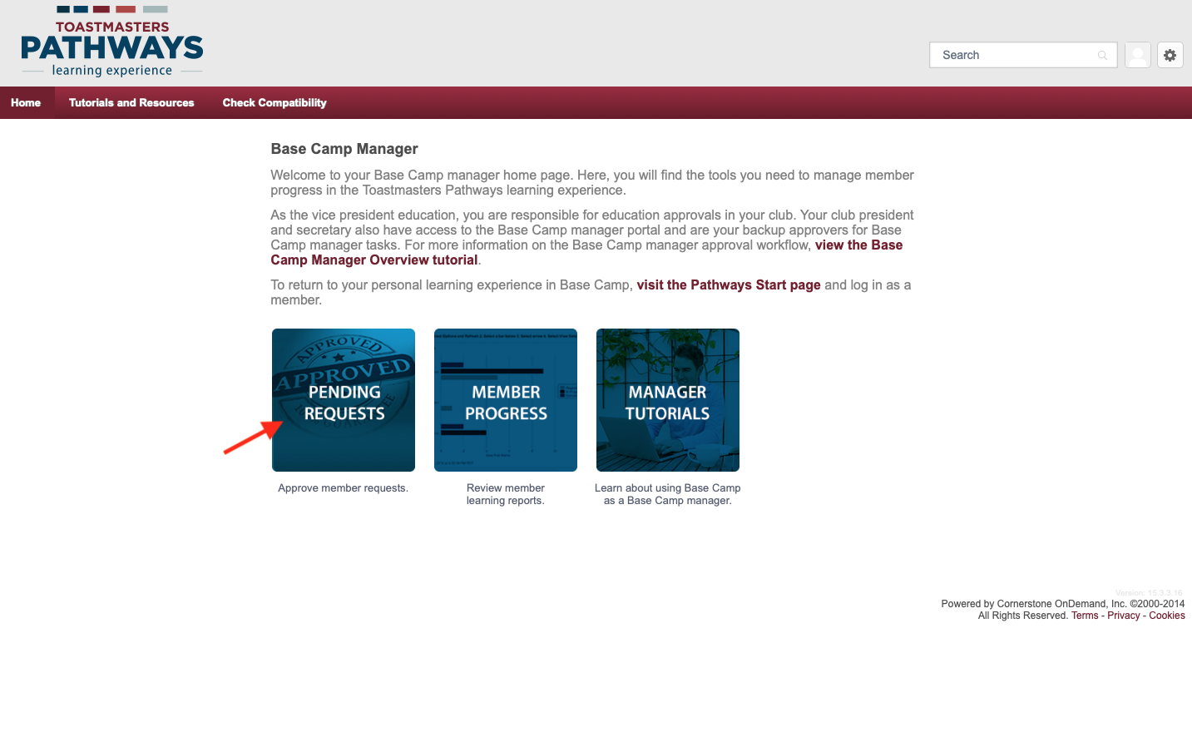
Notes:
Base Camp Manager Tasks Screen – Go to “Pending Requests”

Slide 8
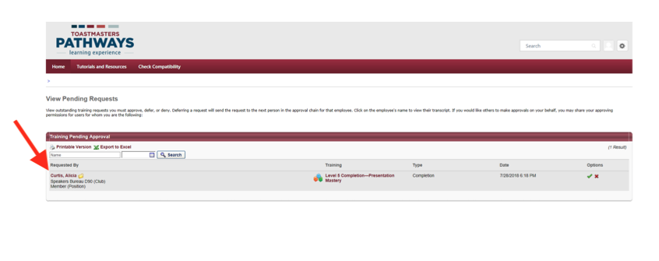
Notes:
Screen Showing Pending Approval – Check name of Toastmaster and other details…

Slide 9
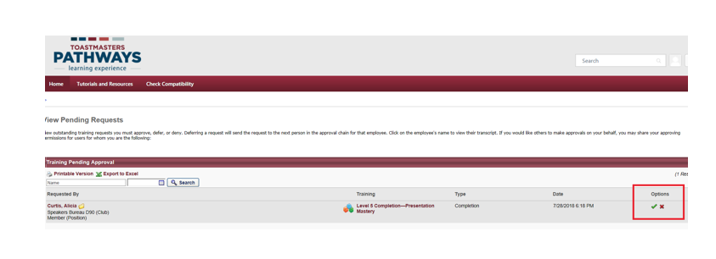
Notes:
Approve or Reject field

Slide 10
Notes:
Toastmasters International Confirmation of Level Approval

Slide 11
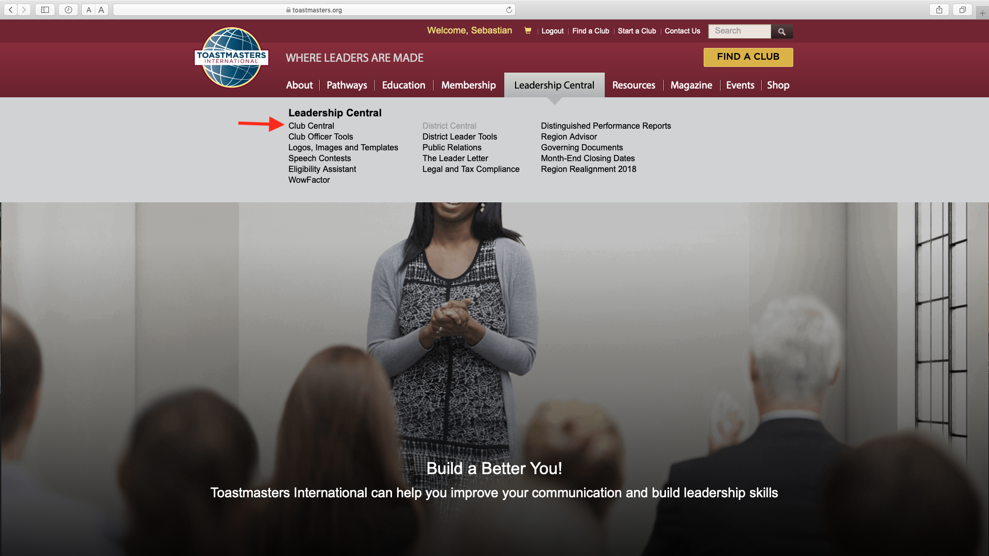
Notes:
Go to the ‘Home” screen, click on Leadership Central and then on Club Central

Slide 12
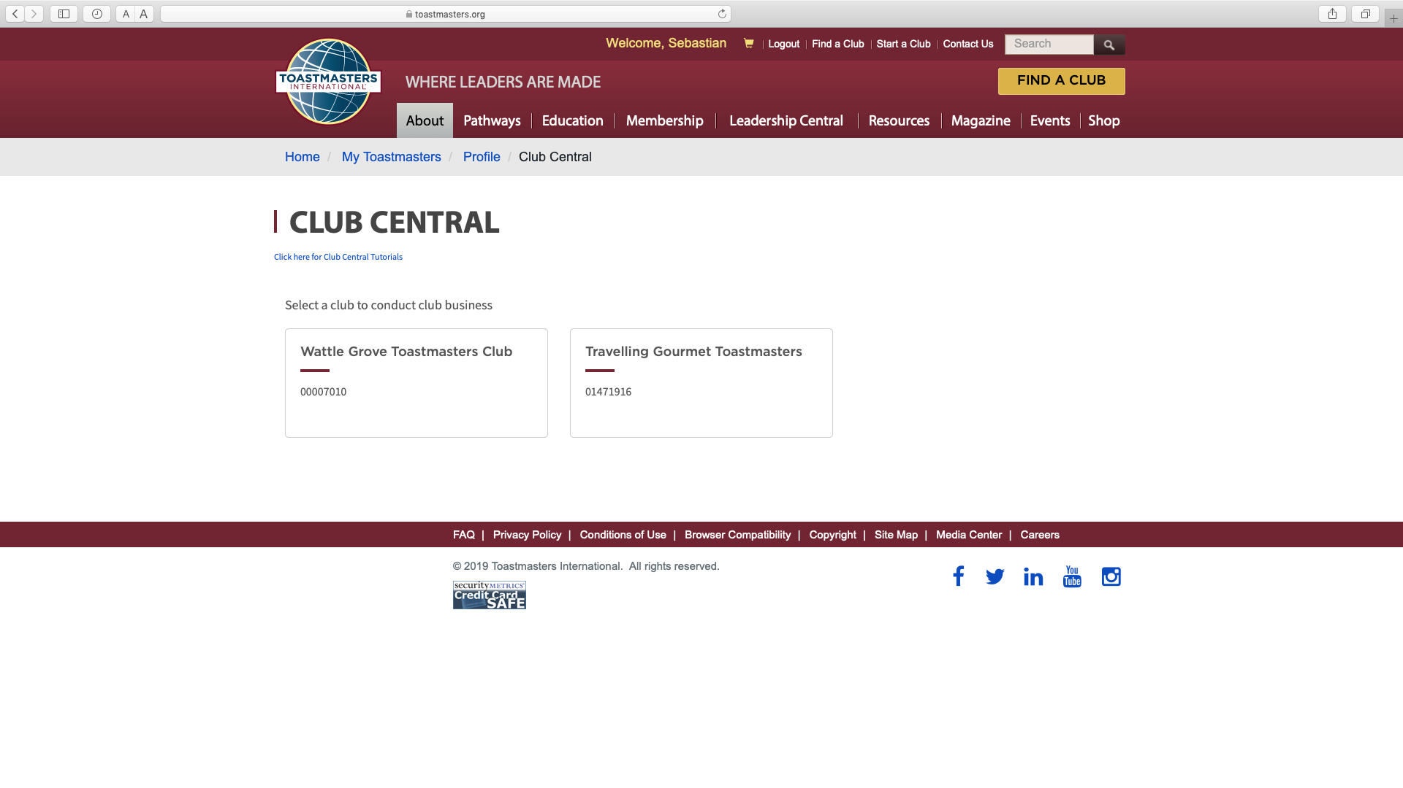
Notes:
The Club Central page will open. Choose the Club you want to interact with by clicking on its name.

Slide 13
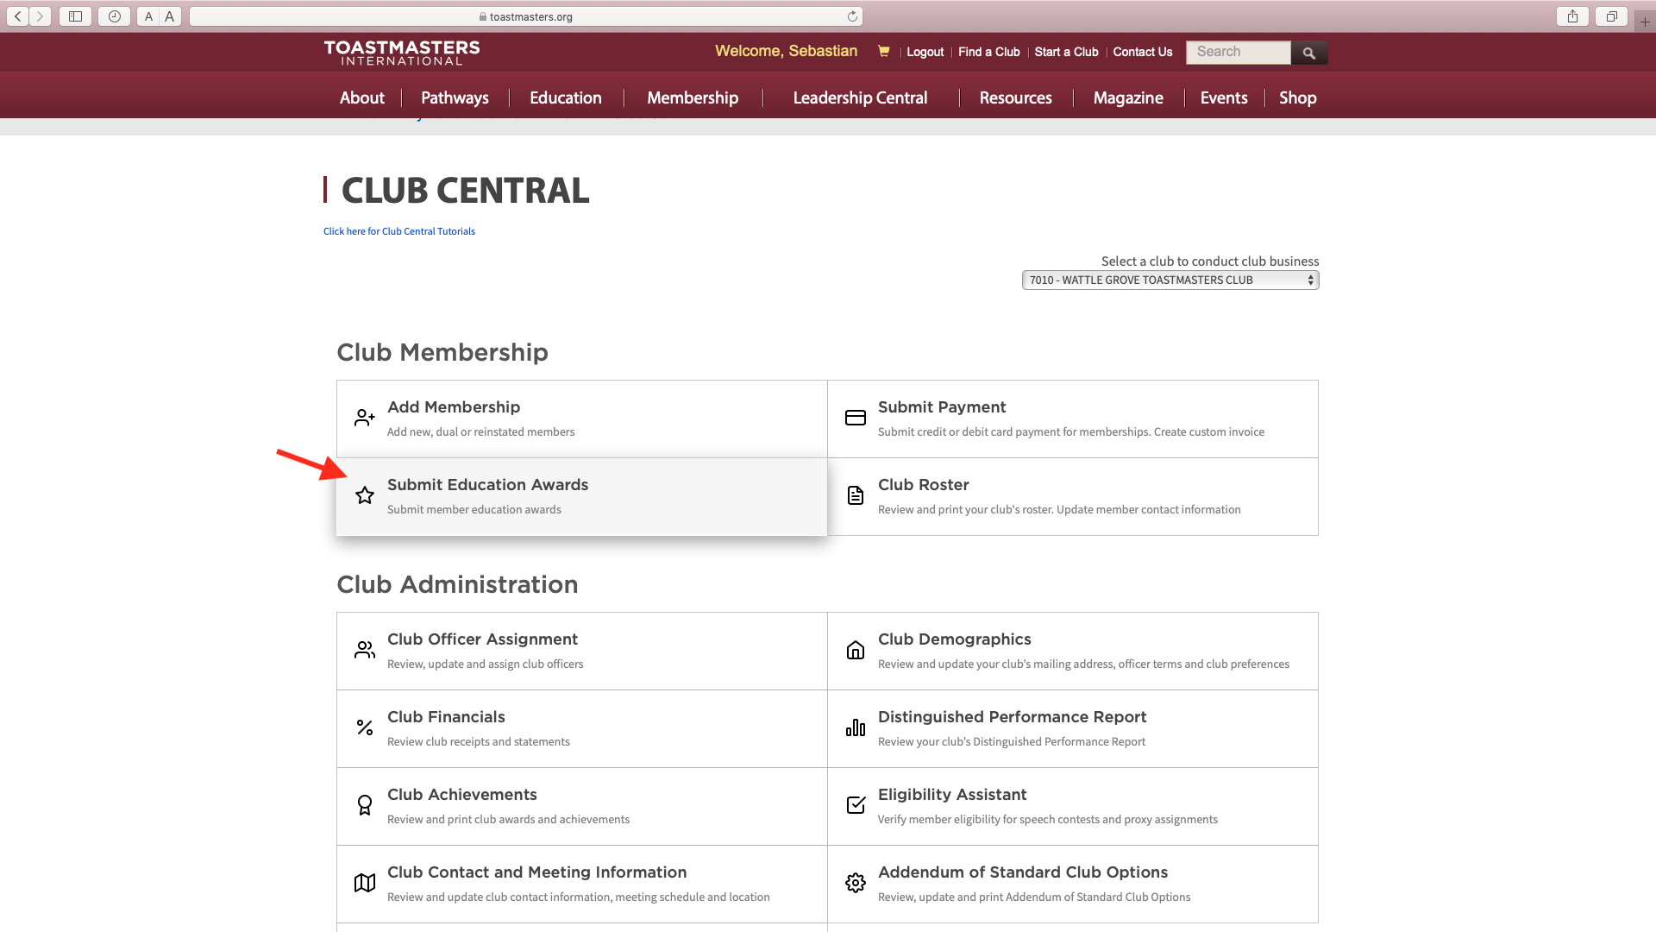
Notes:
Go to ”Submit Education Awards”

Slide 14
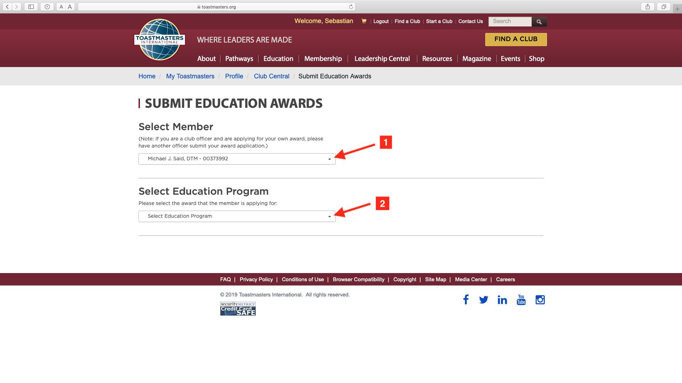
Notes:
Select Member’s name and then the Education Award

Slide 15
Notes:
Toastmasters International Confirmation of DCP Award

Slide 16
REMEMBER!
You should receive two confirmations for each Level you submit
Notes:
Remember! You will receive two confirmations from Toastmasters International

Slide 17
Notes:
Questions from audience

Slide 18
Notes:
End

