Slide 1
HOW TO EVALUATE IN PATHWAYS
District 70
Australia
Notes:
Welcome to this session on How to Evaluate in Pathways

Slide 2
Agenda
Obtain the correct Evaluation Form.
Evaluation Form, Description.
How to Use the Evaluation Form.
How to Save a Completed Evaluation Form in Base Camp.
Notes:
Today we’ll lean where to obtain the correct Evaluation Form, the contents of each of its pages, how to use it and how to save it in Base Camp once it has been completed.

Slide 3
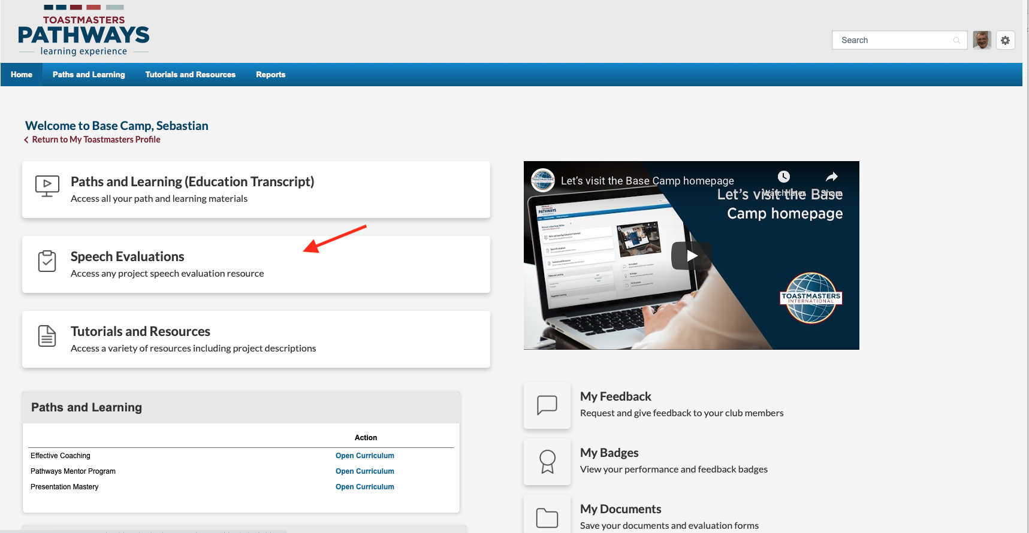
Notes:
Firstly, get the evaluation form form the speaker or access the correct evaluation form from Base Camp from “Speech Evaluations”

Slide 4
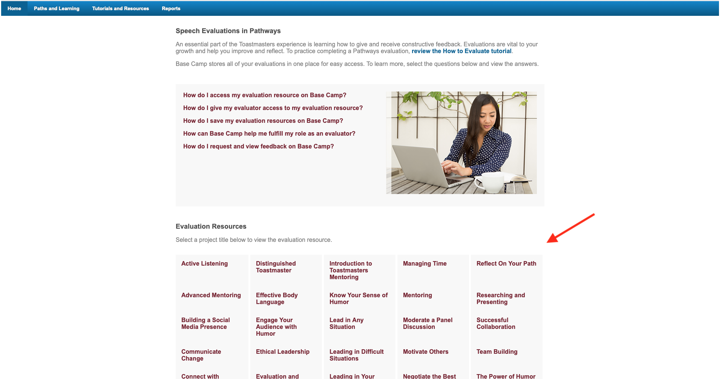
Notes:
Look for the Evaluation form you need (they are kept in alphabetical order). Click on the name and it will download.

Slide 5
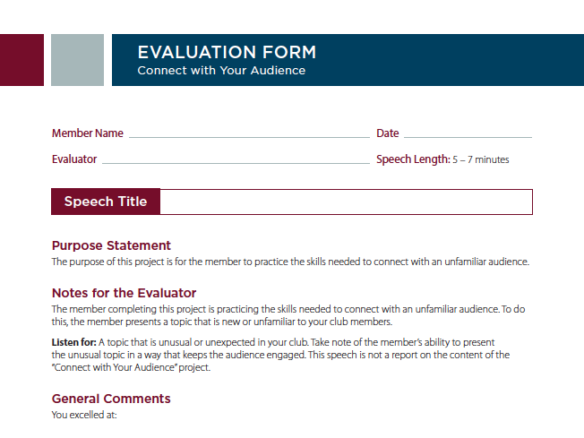
Notes:
When it downloads, it will show on your screen. You can print it or save it to your computer to use it later and complete it online.
Note that the Evaluation Form consists of three (3) pages. The first page is very much like the evaluation pages in the Traditional Educational System.

Slide 6
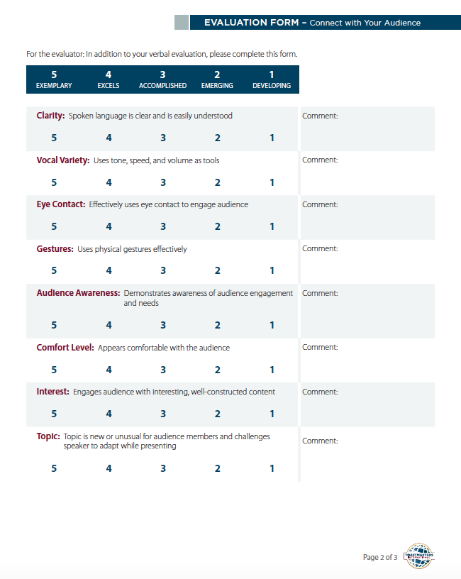
Notes:
The second page is where you rate the speaker on various criteria. Scores are from 1 (low performance) to 5 (exemplary performance)
Scores of 1 and 5 should be used with caution (1 is given when the presenter fails to achieve the criteria and 5 when they have, from your point of view, no more room for improvement).

Slide 7
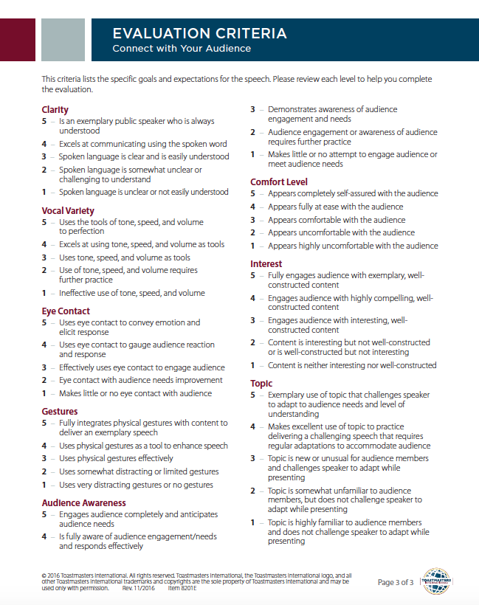
Notes:
The third page is an Evaluation Criteria, a guide for the evaluator on how to mark the speaker in page 2.

Slide 8
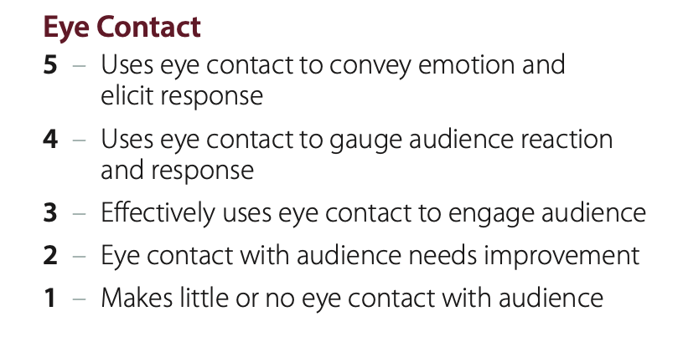
Notes:
This is a close-up example of the Evaluation Criteria for this Project’s Eye Contact.

Slide 9
Go to next slide to learn how to save
the evaluation in
Base Camp
Notes:
Go to next slide to learn how to save the evaluation form in Base Camp

Slide 10
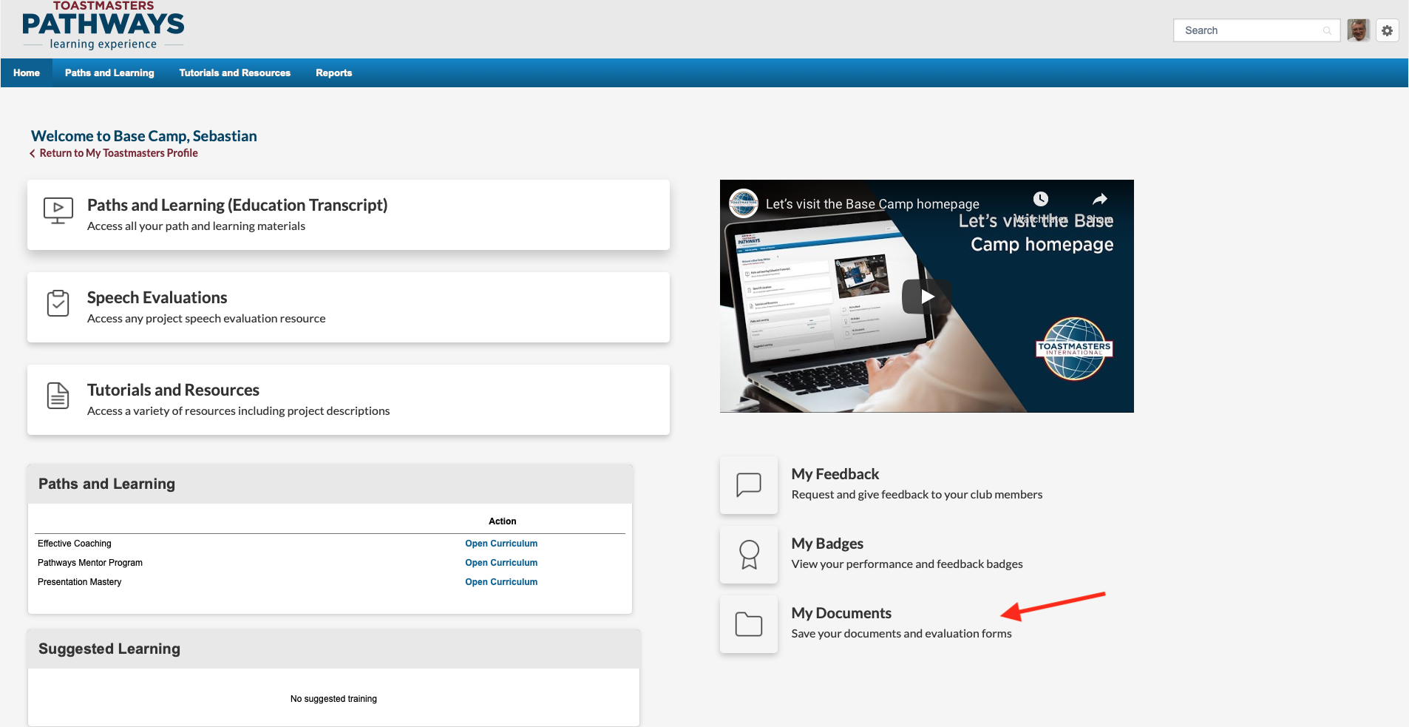
Notes:
Once the speaker receives the evaluation, it can be downloaded to their Base Camp.
First, the evaluation must be saved in the speaker’s computer as a PDF file.
Click on “My Documents” (bottom right hand side of the screen).

Slide 11
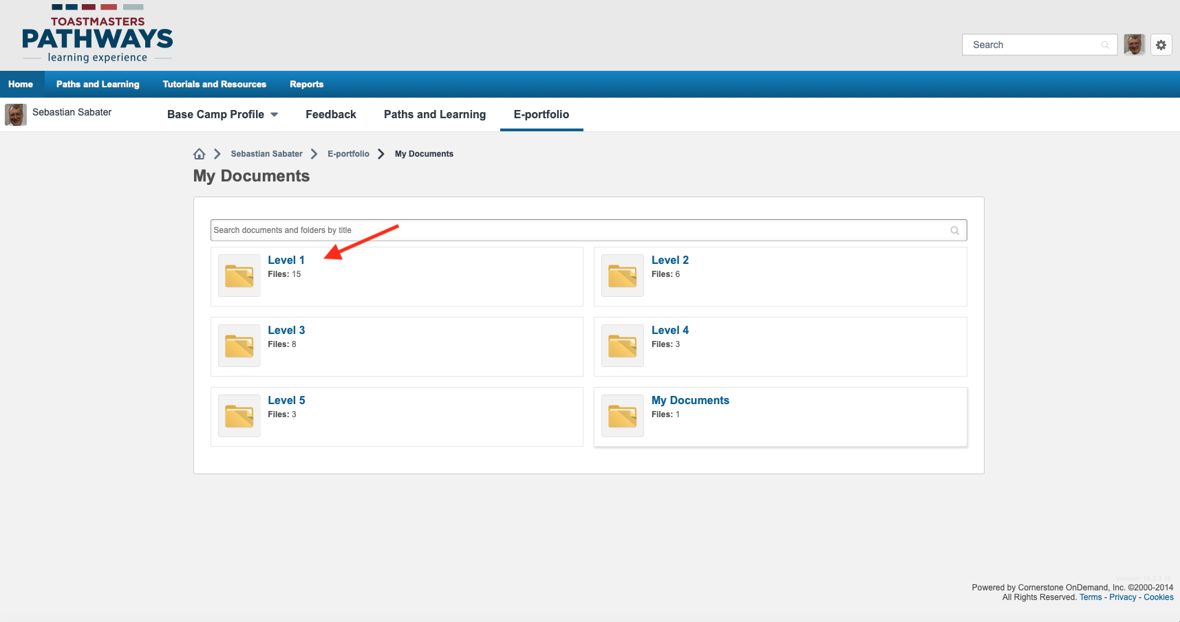
Notes:
This will take you to a page with six yellow folders, where you can store evaluations and other information pertinent to each Path Level.
There is also a folder called “My Documents” to save other materials, if you wish.
To save your evaluation, click on the appropriate folder.
Note: You cannot add or remove folders in this page.

Slide 12
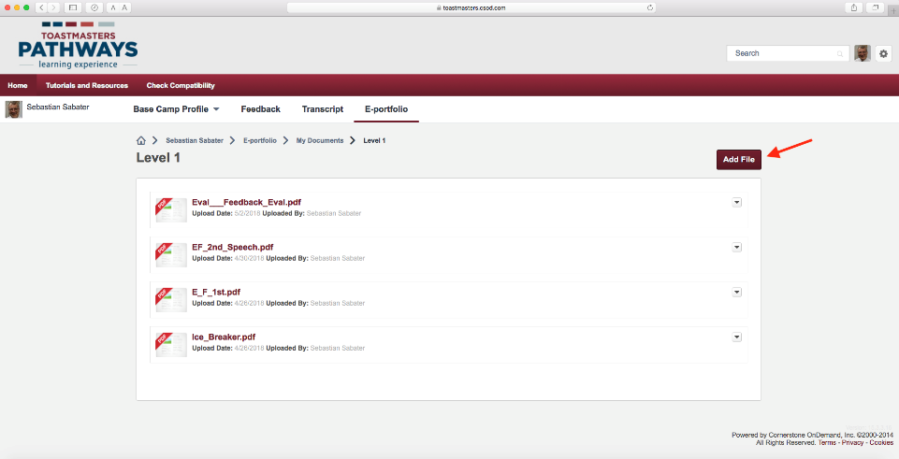
Notes:
To add the file, you need to click on “Add file”

Slide 13
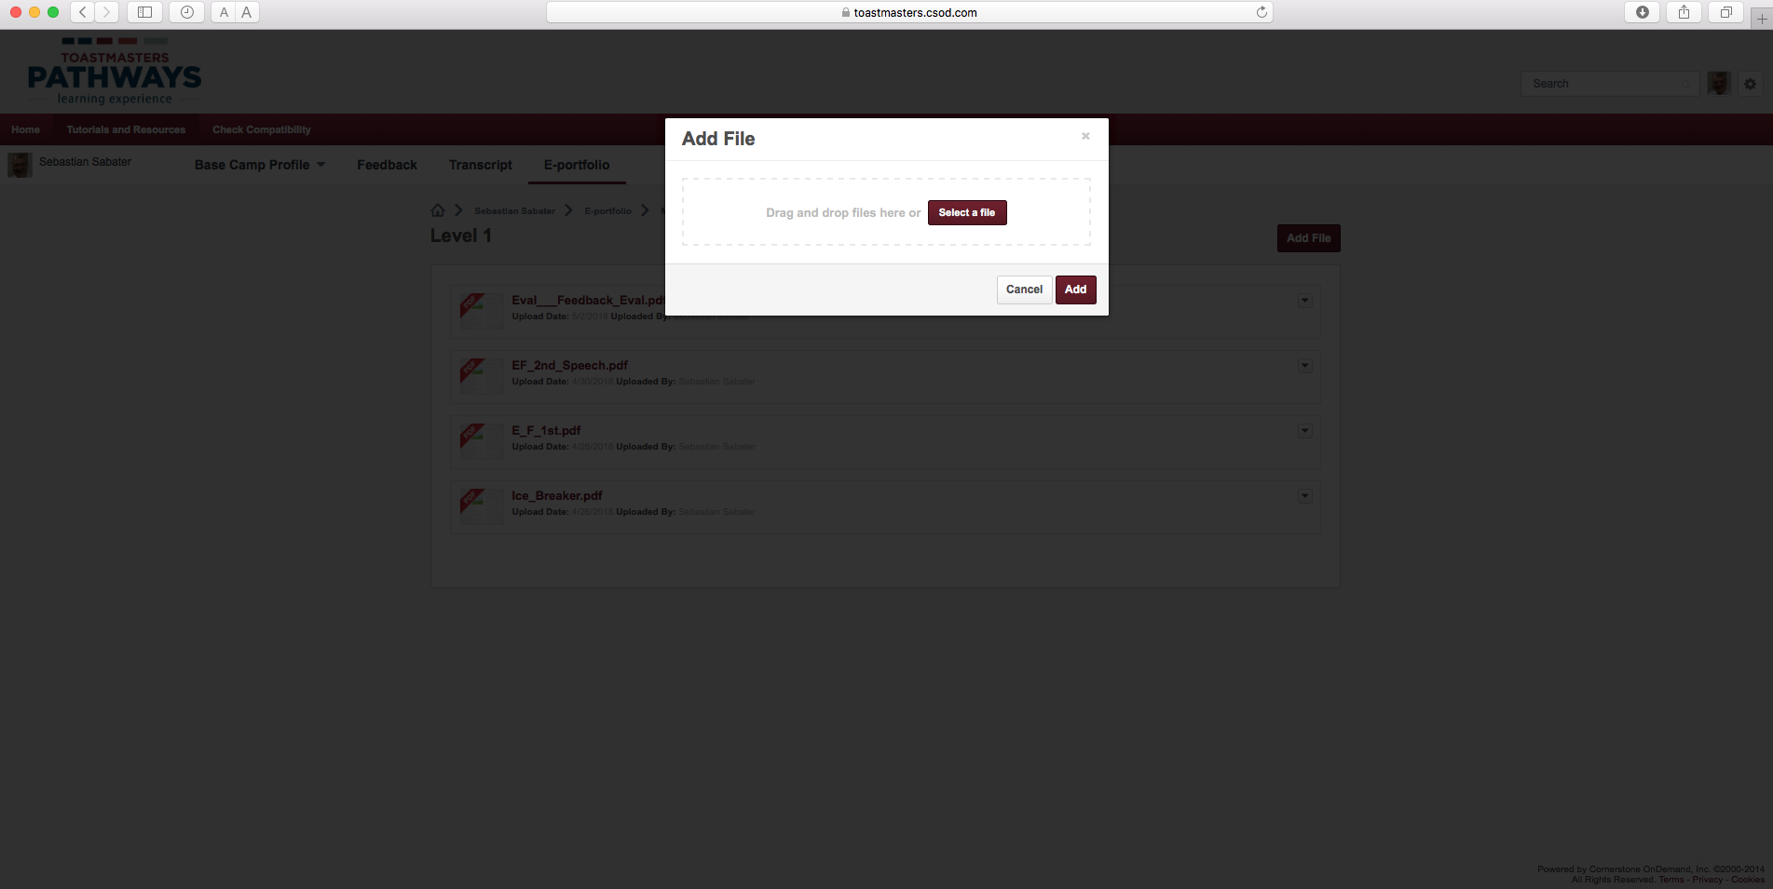
Notes:
You will be prompted to Select a file from your computer or drag it in to the center of the white square.
Once you do that, click on “Add” and your file will be added to your Base Camp records.

Slide 14
Any Questions?…
Notes:
Any Questions?

