Slide 1
ESSENTIALS FOR BASE CAMP MANAGERS
District 70
Australia
Notes:
Hello and welcome to this presentation of Essentials for Base Camp Managers. Thank you for joining us on this District 70’s Second Sunday Monthly Sessions.

Slide 2
Presenter
Sebastian Sabater, DTM
District 70 Pathways Team Leader
Notes:
My name is Sebastian Sabater, I am the District 70 Pathways Team Leader and have been working on Pathways for the last four years…

Slide 3
Agenda
Who is the Base Camp Manager?
Base Camp Manager’s Role
Accessing Base Camp as a BCM
Tracking Members Progress
Level Approval
Tutorials you can Access
Projects Outside the Club
Projects on Printed Materials
Questions
Notes:
Today’s Agenda includes information on… (read from the screen up to Projects on Printed Materials)
At the end we’ll have a Q&A session where I will do my best to explain and answer any queries you may have.

Slide 4
Who is the Base Camp Manager?
Club President
Club Vice President Education
Club Secretary
Notes:
We’ll start by answering the first item in the Agenda, Who is the Base Camp Manager?
The position of BCM is automatically assigned to the President, Vice President Education and Secretary of each Club.
The VPE has the responsibility for ensuring all Educational Achievements are allocated to the members and assigned to the Club’s DCP, but the President and Secretary also have full access to Base Camp and can perform the same verification and approval tasks as the VPE. Note that Base Camp Managers can’t approve their own work, so any achievements accomplished by the VPE must be approved by one of the other two BCMs.

Slide 5
Base Camp Manager’s Role
Track Member’s Progress
Verify and Approve Level Completions
Verify Projects Completed Outside the Club
Verify Projects on Printed Materials
Notes:
The Base Camp Manager's role is to ... (read from the screen)

Slide 6
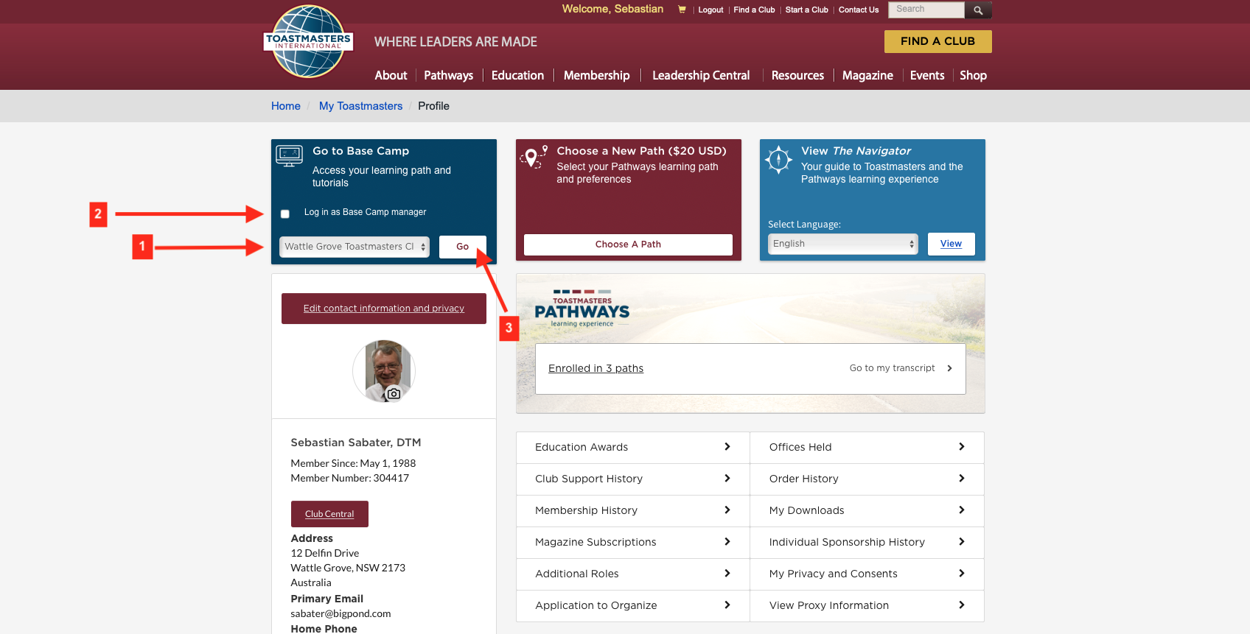
Accessing Base Camp as a Base Camp Manager
Notes:
To access Base Camp as a BCM, first you must login to the Toastmasters International website and then access your Profile page by clicking on your name at the top center of the page.
On the Profile page, go to the dark blue tile, on the left hand side of the screen and, if you are member of more than one Club, choose the Club you want to log in to, click on the small white square to indicate you want to login as a BCM and then click on "Go"

Slide 7
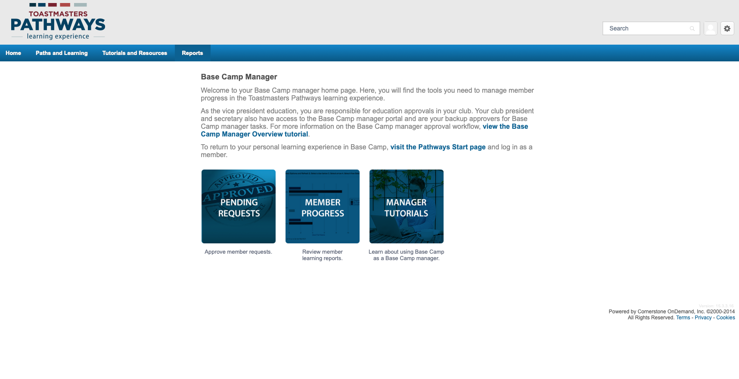
Notes:
This will take you to the BCM home page, where you will see three large blue tiles.

Slide 8
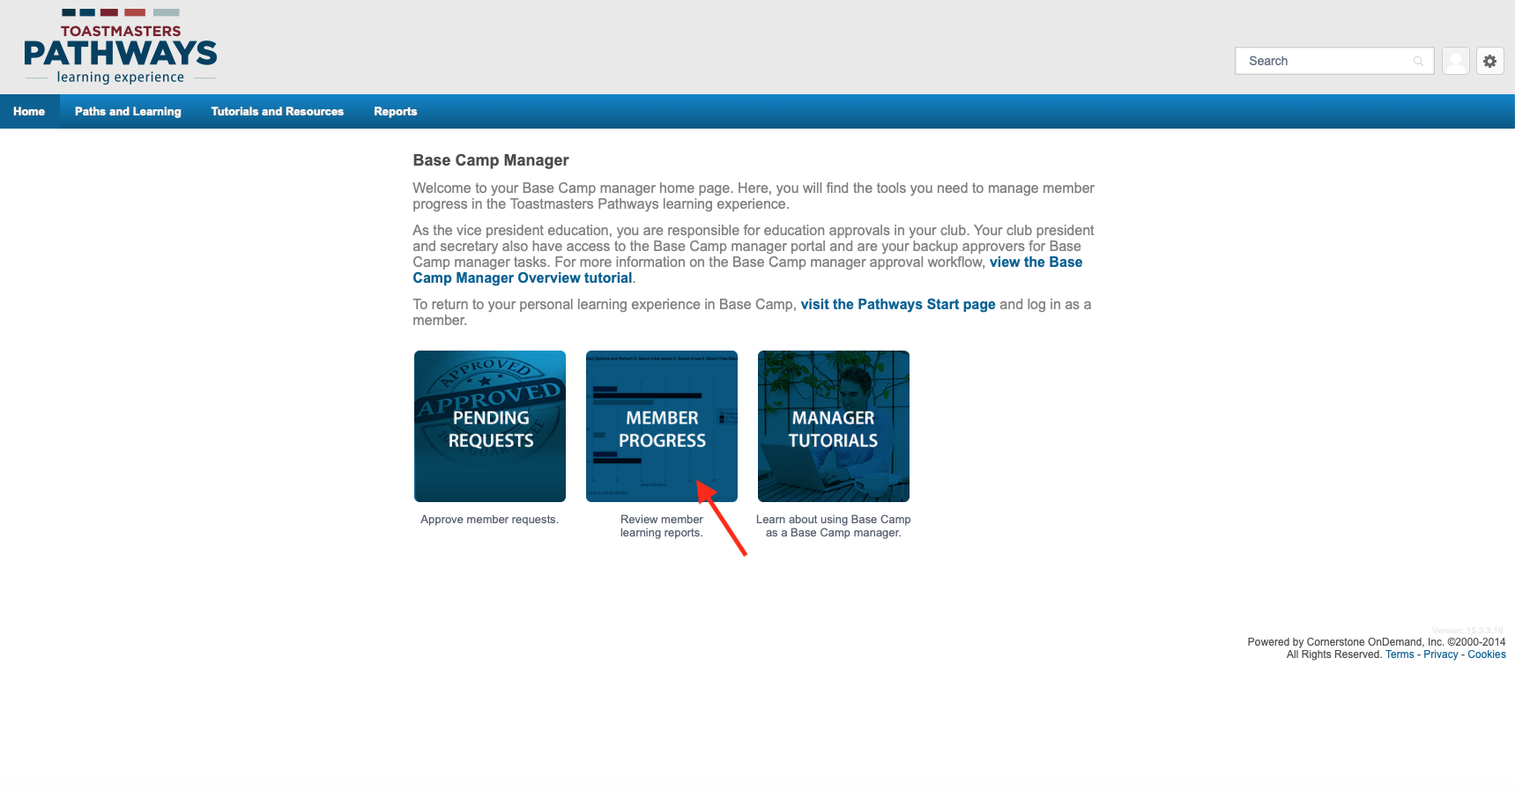
Tracking Members Progress
Notes:
To check on any of your Club members' progress, click on the centre tile ”Member Progress”.

Slide 9
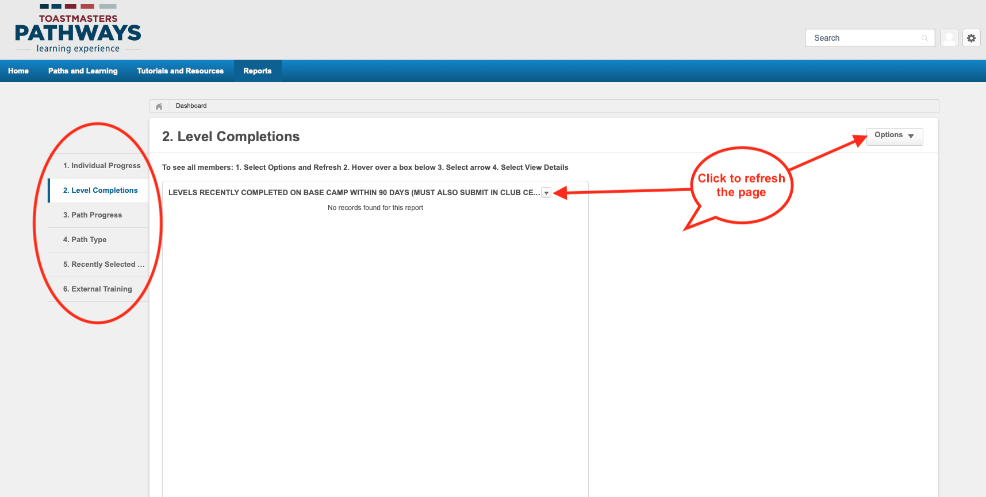
Notes:
This will take you to the "Reports" page, where you will be able to choose on a number of reports listed on the left hand side of the screen.
If the page has no information, you must refresh it by clicking on the small down arrow next to the word "Options" on the top right of the page or on the small black arrow that appears when you hover your mouse on the centre top of the screen.

Slide 10
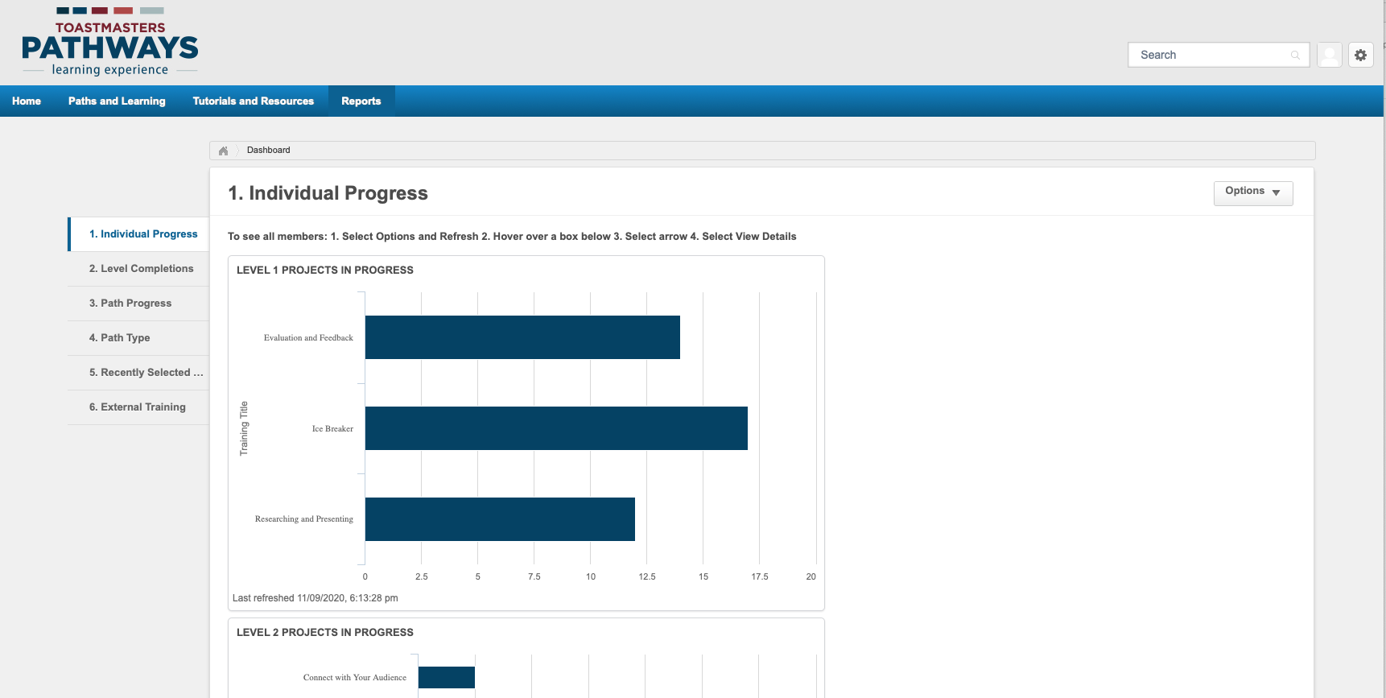
Notes:
When the page refreshes, the information appears in the form of graphs. In this example, showing the individual progress by Level and by Project.
Scroll down the page to see more information or follow the instructions on the top of the page.

Slide 11
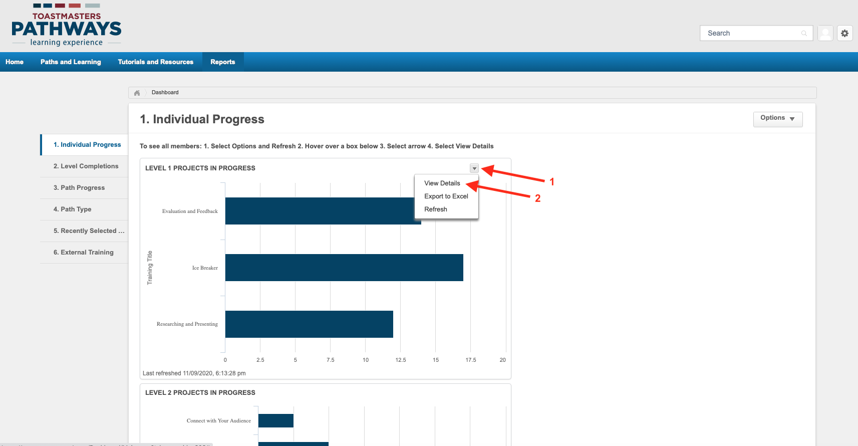
Notes:
If you'd like to see the names of the members that are working on each Project, click on the small black down arrow that appears when you hover your mouse on the top right hand side of each graph. The click on "View Details" on the small drop down window.

Slide 12
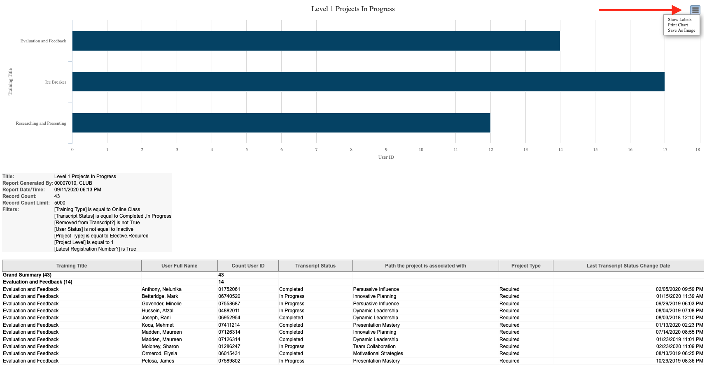
Notes:
A new page with the names of members working on each Project appears bellow the graph. You can scroll down the page to see all the information.

Slide 13
Level Approval
Notifications from Base Camp and Club Central.
The Two Step Process.
How to Log in as a Base Camp Manager.
How to Approve or Reject a Level Completion.
How to Access Club Central.
How to Lodge an Achievement in Club Central.
Notes:
Our next topic is Level Approval. I will take you through the process, that includes... (read from the screen)

Slide 14
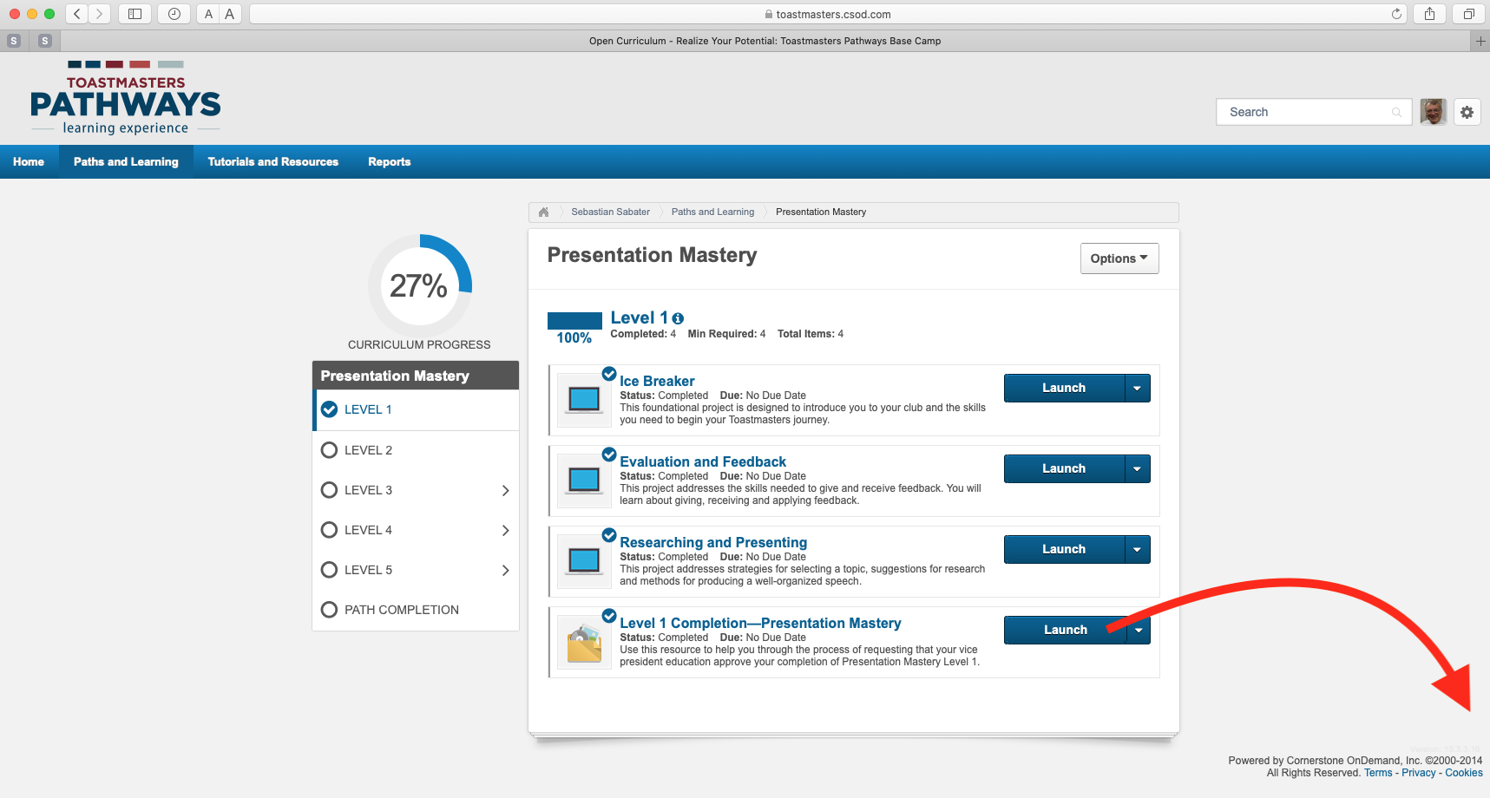
genericemail@myclub.com
Club President
Club VPE
Club Secretary
Notes:
When a member completes a Level and Launches Completion, a notification is automatically sent to the Club's registered email with T.I.
It is good practice for Clubs to have a generic email address registered with T.I. and for the BCM's to have access to it.

Slide 15
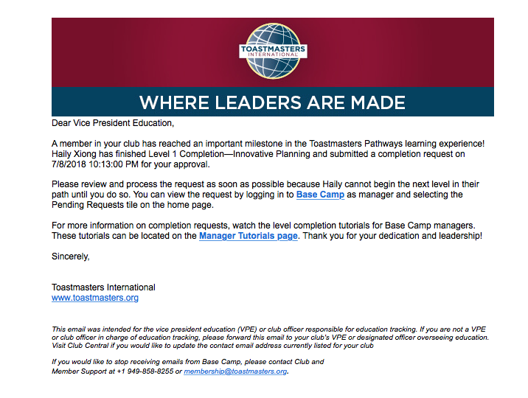
Notes:
This is a sample of the automatic notification email.
As you can see, it gives the name of the member and the Level they have completed, as well as instructions on how to process the approval.

Slide 16
In Pathways, Level Approval is a two-step process.
The Base Camp Manager MUST:
Approve the Level completion in Base Camp
  (this will give the Member credit for the having completed the Level)
Enter the Level completion in Club Central
(this will lodge the achievement in the Distinguished
Club Program)
Notes:
Remember that, in Pathways, Level Approval is a two step process...
You must approve the Level first in Base Camp (this will credit it to the member)
and then in Club Central (to register it in the Club's DCP).

Slide 17
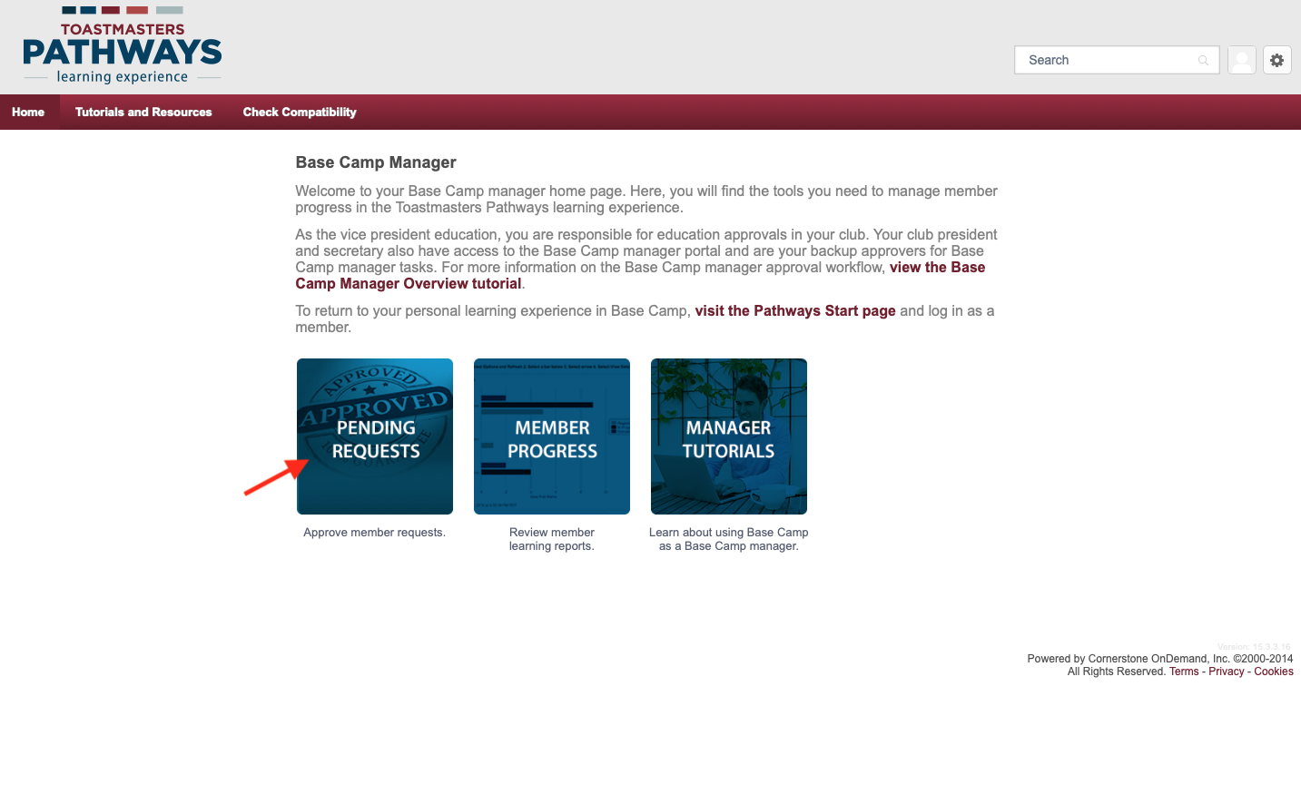
Notes:
After you receive notification that a Level has been completed, login as BCM and go to the BCM home page.
Click on the "Pending Requests" tile and it will take you to...

Slide 18
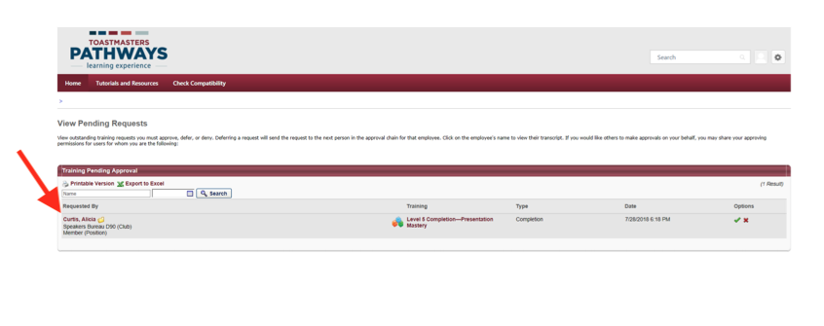
Notes:
...the Pending Requests page.
The member's name and details of the Level completed will show.

Slide 19
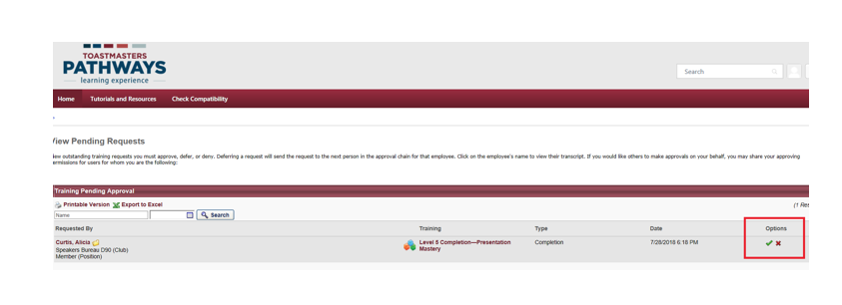
Notes:
Check the Club's records or/and ask the member for proof of completion, if required, and if satisfied that the Level has been completed, approve it by clicking on the green tick on the right hand side of the page.
If you are not satisfied that the Level has been completed, you can reject the request by clicking on the red arrow.
A small window will appear on the left hand side of the screen, where you can write a message to the member, explaining your reason for approval or rejection. The member will receive the message by email.

Slide 20
Notes:
When you approve the Level, an automatic email will be sent to the member and to the Club's registered email with T.I., confirming your approval.
This is a sample of the email.

Slide 21
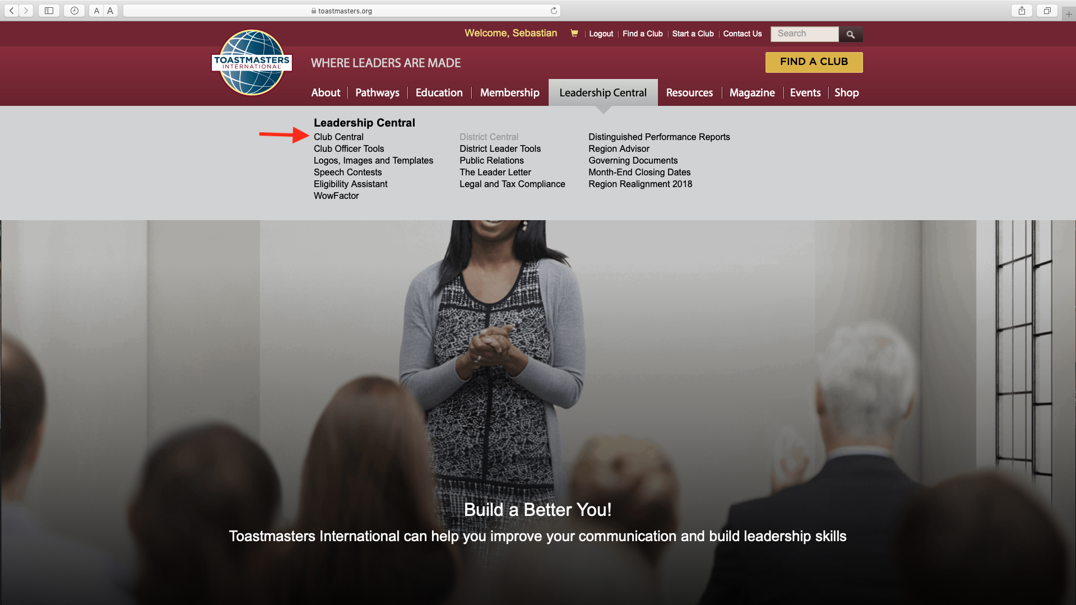
Notes:
Your next task as BCM is to register the Level in Club Central.
Members registered with more than one Club must decide which of their Clubs will receive the Award. Always check with the member before registering the Award with Club Central, since once it has been registered with a Club, the Award can't be transferred to another.
Once the member has confirmed they want the award to go to your Club, login to the T.I website, and on the main page click on "Club Central", a number of options will appear on a drop down menu. Click on "Club Central" and the Club Central page will come up.

Slide 22
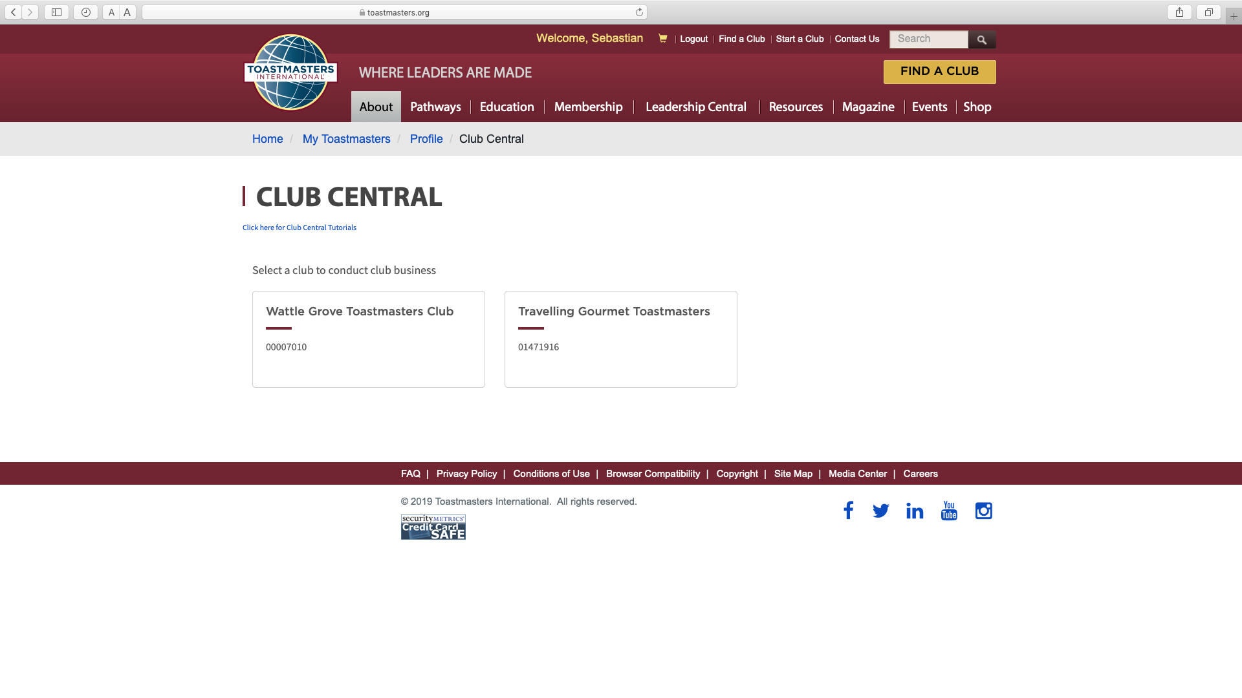
Notes:
If you have access to more than one Club records, click on the Club that is to receive the Award. A new screen will appear.

Slide 23
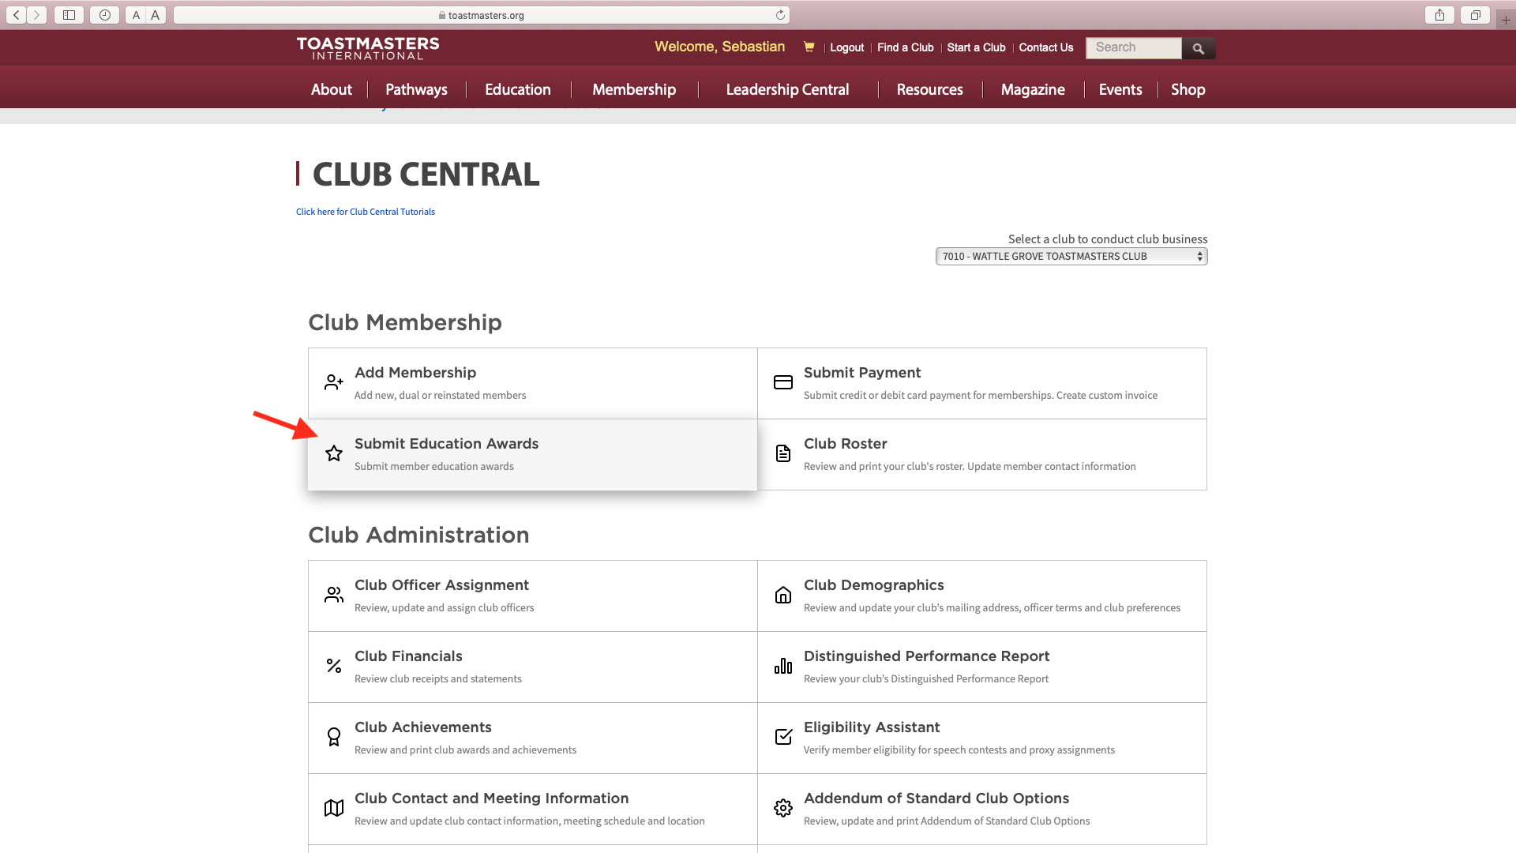
Notes:
Click on "Submit Education Awards"

Slide 24
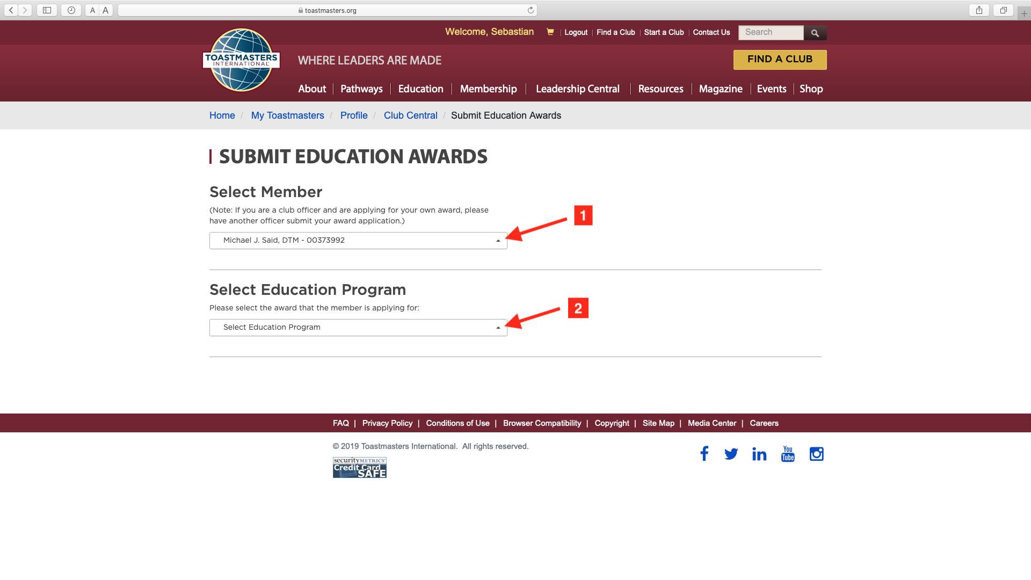
Notes:
Another screen will appear. A list of Club members will show under "Select Member". Click on the name of the member that achieved the Award and then, under "Select Education Program", click on the Award that has been achieved.

Slide 25
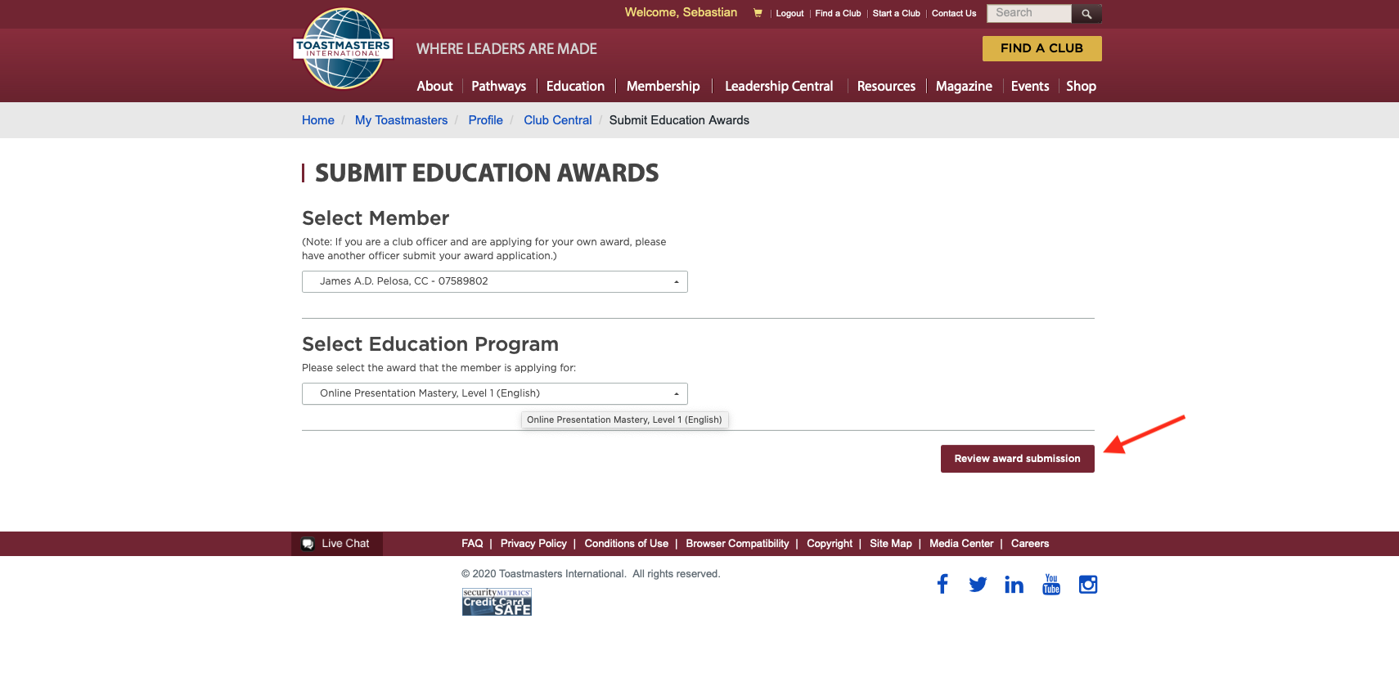
Notes:
A "Review and Submission" button will come up on the bottom right hand side of the screen. Click on it to confirm.
This will allocate the Award to your Club's DCP.

Slide 26
Notes:
A notification like the one shown, will be sent to the member and to the Club's registered email address with T.I.

Slide 27
REMEMBER!
You should receive two confirmations for each Level you submit
Notes:
Remember...
You should receive two confirmations, one after you enter the Award in Base Camp
and another when you submit it in Club Central.

Slide 28

Tutorials you can Access
Notes:
As a Base Camp Manager, you can access a number of Tutorials that will help you perform the various activities for your role.
Go to the BCM home page and click on the "Manager Tutorials" tile.

Slide 29
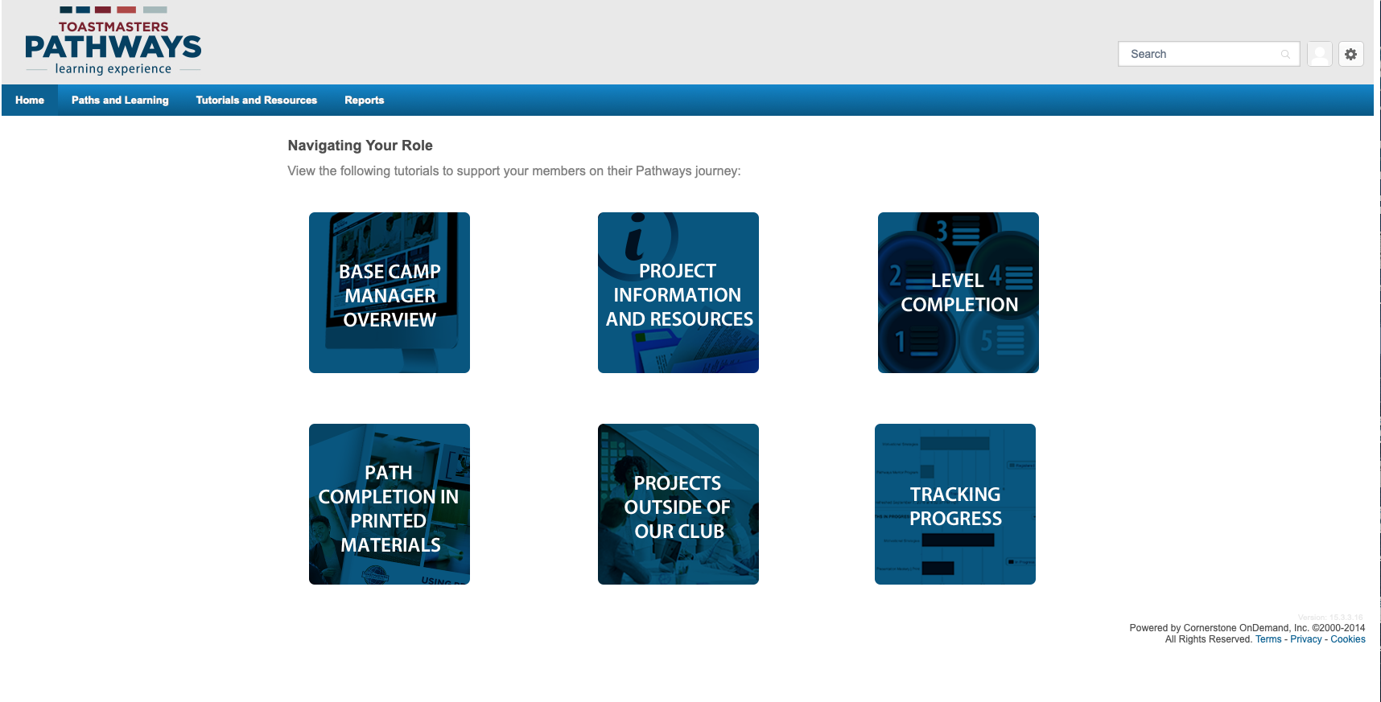
Notes:
This will open a new page with six blue tiles. Each one has a number of educationals (PDF files, interactive pages or short videos) on the various subjects.

Slide 30
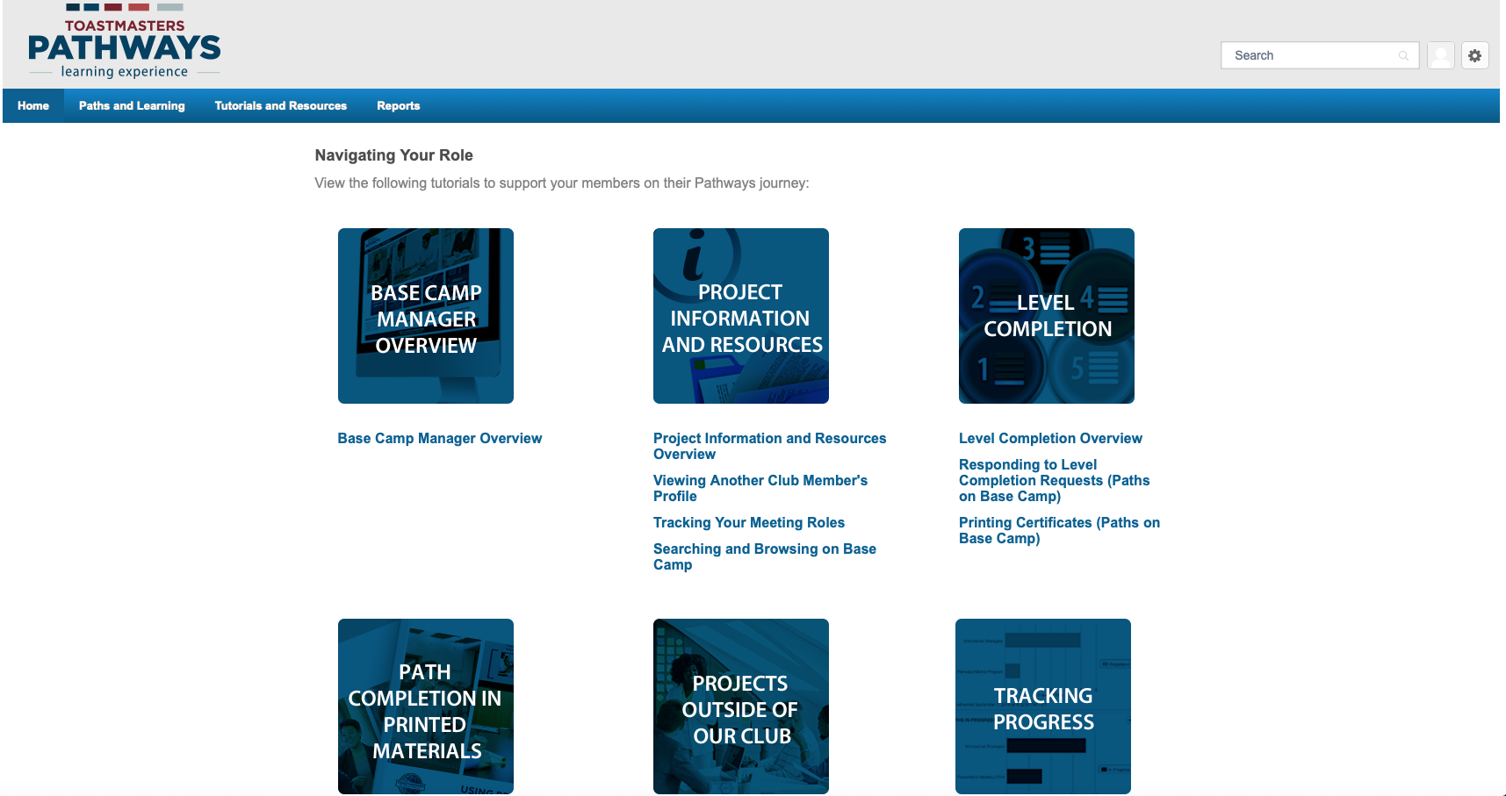
Notes:
If you click on a tile, a list of educationals on that subject will display below the tile. Click on the name of the educational and it will open for you.

Slide 31
Projects Outside the Club
Notes:
A Club member may choose to do a Project outside their Club; at another Toastmasters Club or at a non-Toastmasters organisation.
Pathways provides a recording and approval system to facilitate this process.
It is not mandatory for members to use this system to notify their VPEs when they do a speech outside their Club, but it assists the BCM to confirm all tasks have been completed prior to approving a Level.
To access the tutorials, go to the BCM home page and click on the "Manager Tutorials" tile.

Slide 32
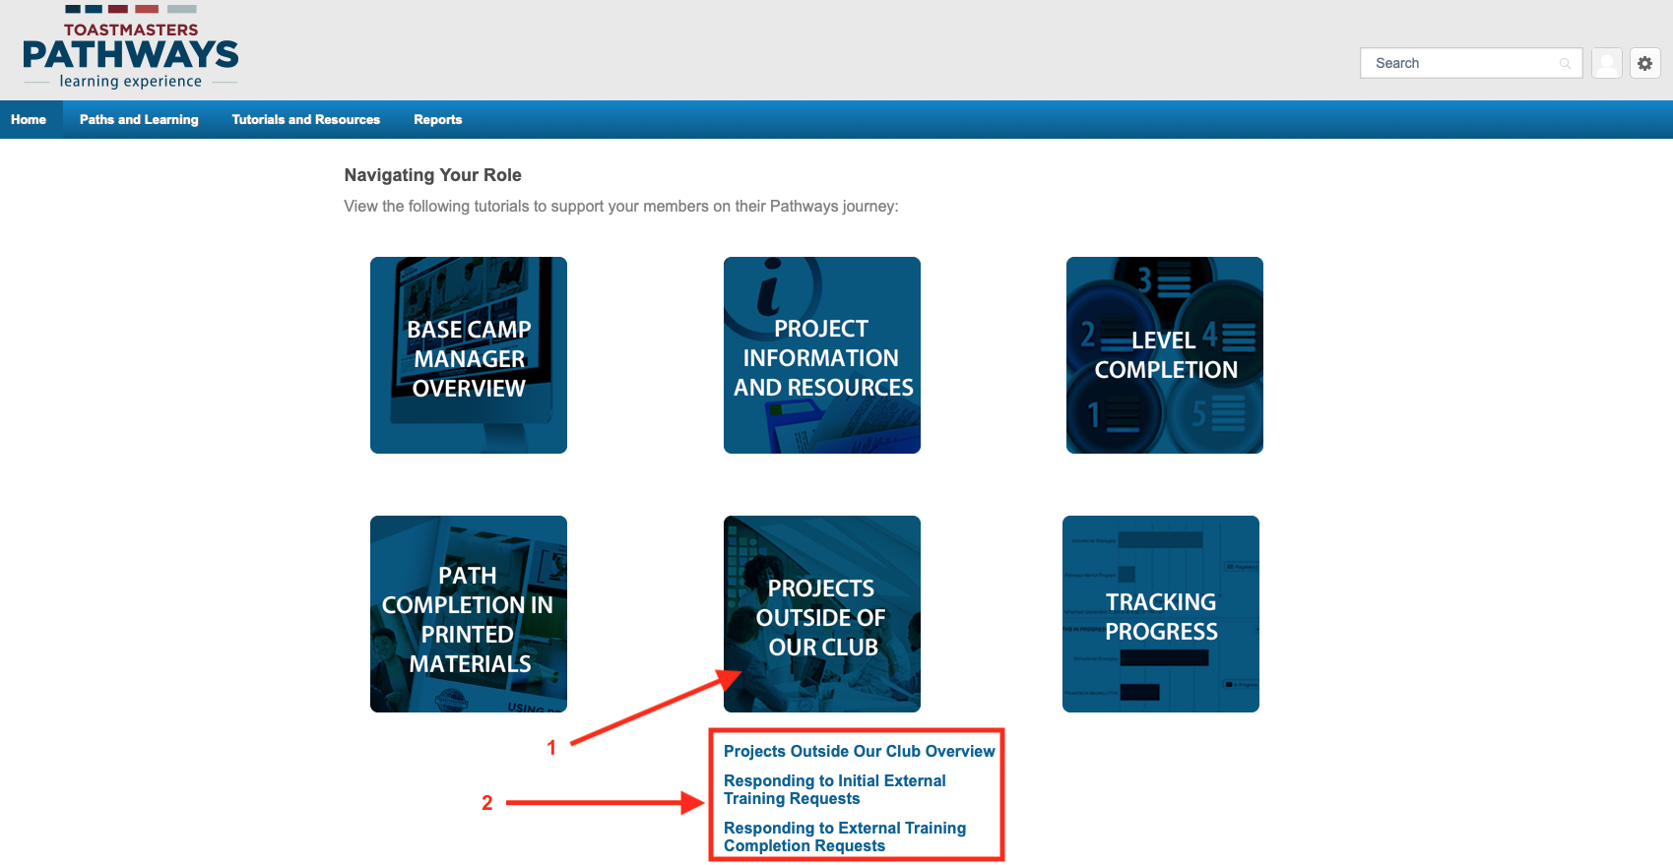
Notes:
On the new page, click on "Projects Outside of Our Club" and the list of tutorials will show. Click on the one you want to learn about.

Slide 33

Notes:
This is a sample page of one of the interactive tutorials.

Slide 34
Projects on Printed Materials
Projects on Printed Materials currently represent about 0.5% worldwide, of the total number of Paths taken up by Toastmasters.
Each individual Project must be validated by a Base Camp Manager and Levels approved on completion.
Notes:
Projects on printed materials currently represent about 0.5 % worldwide, of the total number of Paths taken up by Toastmasters.
Each individual Project must be validated by a BCM and Levels approved on completion.

Slide 35
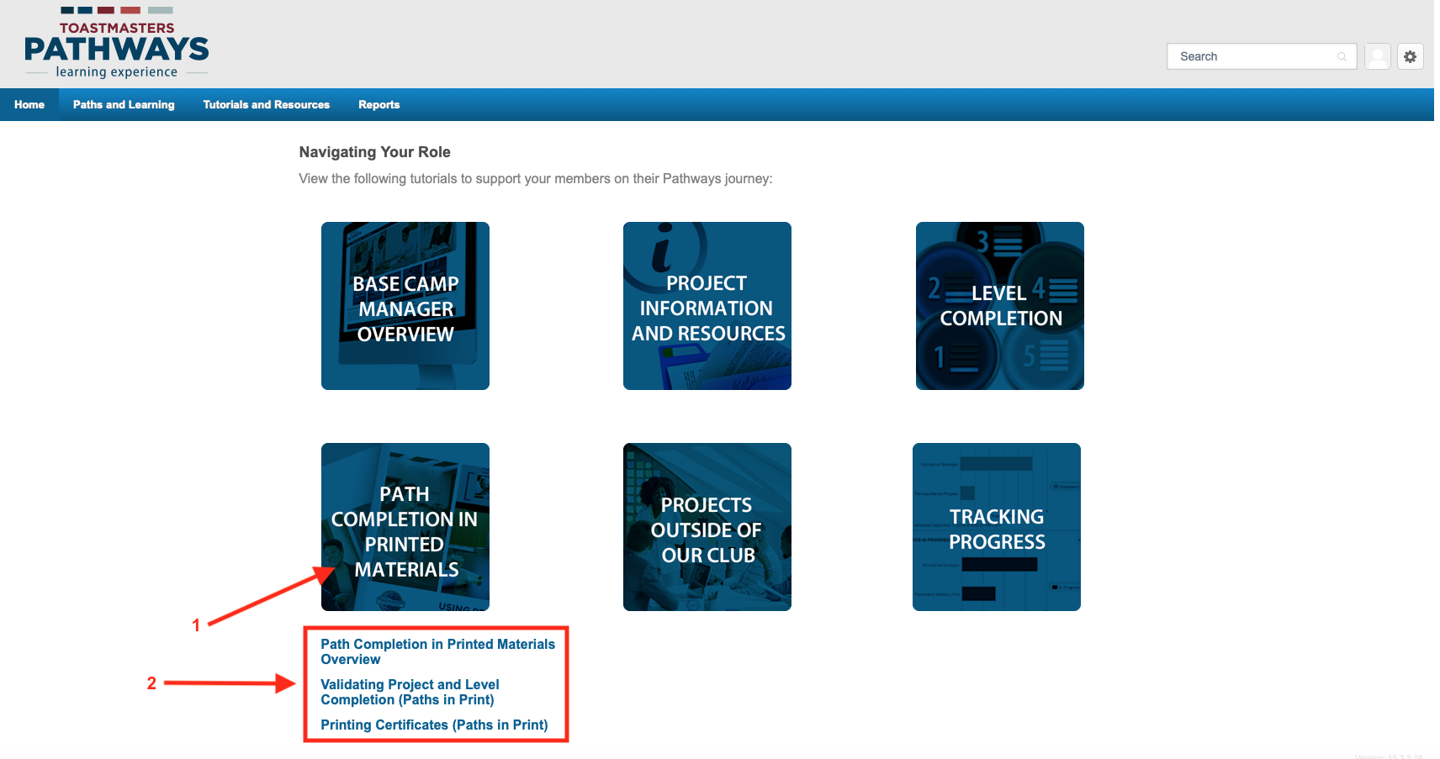
Notes:
Click on the "Path Completion in Printed Materials" tile to reveal the educationals available on this subject.

Slide 36
In Summary, we have learnt…
Who are the Base Camp Managers
What is the Base Camp Manager’s Role
How to Access Base Camp as a Base Camp Manager
Tracking Members Progress
Level Approval (the two-step process)
Tutorials you can Access
Projects Outside the Club
Projects on Printed Materials
Notes:
We have now reached the end of this session.
In summary, we have learnt... (read from the screen)

Slide 37
Questions?
Notes:
Are there any questions?

Slide 38

Notes:
Many thanks for your interest and attention.

